Slide 1

Non-Traditional Provider Management
Point of View
Enterprise Software Architecture
January 2018

Slide 2
Agenda
Introduction
Business Problem
Options Evaluated
Option Analysis
Conclusion
Appendix
Option Advantages & Disadvantages
Definitions
Define non-traditional providers
Future Healthcare Provider Management

Slide 3
Introduction
EA has been asked for a point of view on how Aetna should manage non-traditional providers
Non-Traditional providers are critical to our Community Care strategy
Based upon our preliminary analysis, a “shadow” solution that mirrors the traditional provider facility (EPDB) would be our best option
This deck outlines the options evaluated and the rationale behind that opinion

Slide 4
Business Problem
“Non-Traditional” Providers have similarities to Aetna’s “Traditional” Providers but introduce new challenges
Non-traditional Provider Management
Provider Management
“Traditional” Provider Specific
Network Association
Clinical specific reimbursement process (via claims)
Clinical specific credentialing process and quality metrics
Defined contracts
Affiliations to Hospitals / Orgs
Recognized by CMS
Similarities
Focus on providing services for patients/members
Demographic “contact” information
Provider Search
“Non-Traditional” Provider Specific
Geolocation / Network (none right now)
Community services at no cost vs fixed cost vs fee for service (unknown model)
Criteria for selecting and measuring a non-traditional provider (unknown)
Rates / costs for services (unknown model)
Affiliations (unknown model)
Regulatory requirements (unknown)

Slide 5
Business Problem
We haven’t figured it all out yet….and it’s a moving target
Level of Service
Data Quality
Can we trust the data quality that third party vendors provide? Aetna currently doesn’t have any validation criteria or processes to filter vendor driven data.
Market Demands
Expecting high growth in the need for services.
How do we pay for services?
Community Care Group (FL to Texas) – 5M
How do we know we have a “good” provider?
How do we measure whether they are doing a good job?
What are recommended Industrial Standards?
How will we track the service data?
How will we collect data to study the results (analytics)?
Local building codes and other regulations?
Do we understand what levels of service we need to support?
Do we understand who the providers are?
Is there a CMS violation if the benefit is not written into the plan?
What is the “approval” process for a service/provider?
DME vs provider (i.e. is a ramp a piece of equipment and the installation is part of the price/contract with the vendor or do we independently contract with someone to install/build?)
Credentialing
Any solution must provide the flexibility to allow our capabilities to evolve and adapt as we grow this market

Slide 6
Options Evaluated
Option 1
Reuse traditional Provider Management (EPDB)
Option 2
Reuse / expand the EAP solution extracted for the pilot (look more closely into Resources For Living (RFL))
Option 3
Build a new non-traditional Provider Management platform
Option 4
Option 5
Leverage the AssureCare MedCompass platform capabilities (tactically being used today)
Buy a new Vendor Product

Slide 7
Option Analysis
Measures | EPDB | RFL | AssureCare | Vendor | New
Implementation Cost | H (5) | L (1) | M (3) | H (5) | M (3)
Risk of Downstream System Impacts | H (5) | L (1) | M (3) | M (3) | L (1)
Operational Cost | L (1) | M (3) | M (3) | M (3) | M (3)
Maintenance Cost | H (5) | M (3) | L (1) | L (1) | L (1)
Integration Cost with Aetna Ecosystem | M (3) | M (3) | L (1) | M (3) | L (1)
License Cost | L (1) | M (3) | L (1) | M (3) | L (1)
Sub Total | 20 | 14 | 12 | 18 | 10
Ability to meet functional needs | M (3) | M (5) | M (3) | H (5) | H (5)
Ability to scale | H (5) | L (1) | H (5) | H (5) | H (5)
Ability to adapt to new market needs | L (1) | M (3) | M (3) | M (3) | H (5)
Ability to simply / unify data management / to create consolidate provider search | H (5) | L (1) | L (1) | M (3) | M (3)
Robustness of technical platform | H (5) | L (1) | H (5) | H (5) | H (5)
Sub Total | 19 | 11 | 17 | 21 | 23
Least Expensive
Cost
Most Effective
Capability

Slide 8
Conclusion
Based upon this preliminary analysis, considering our community care strategy, the build option is the best fit because
There are still many unknowns with the business model and with the future direction of community care; the build option gives us the most flexibility to evolve and innovate with the least risk to other Aetna assets and programs
EPDB and AssureCare provide many of the needed capabilities but the risk of disrupting ongoing programs and impacting other systems is high.
The existing tactical solution does not have the technical underpinnings to operate at scale and participate in the Aetna Ecosystem; learnings from this solution can be applied to the new solution
Vendor solutions require an up front investment (the build solution allows us to spread the cost incrementally) and could limit our ability to innovate in this market
COTS (Commerce Off The Shelf) components should be leveraged to expedite the construction of core contact / demographic functions for the custom build solution.
Once market direction and core capabilities are well known, the EPDB and AssureCare options should be revisited.

Slide 9
Appendix

Slide 10
Option1. Reuse traditional Provider Management (EPDB)
Advantages
EPDB has a proven ability to scale.
EPDB has a proven ability to simplify and unify data management, and to support a consolidated provider search.
EPDB is built on a robust technical platform.
EPDB is designed for the Aetna Traditional Provider partners, that will have networks and will submit claims.
EPDB has low operational cost is low due to it’s scale and infrastructure
License cost is not required since EPDB is owned by Aetna
Disadvantages
Risk of downstream system impacts is very high. Today EPDB has over 300 integrations, with over 60 applications, and is involved in over 120 projects (over the past 5 years).
Risk of disruption to current large programs is high. Due to the large number of projects / programs, the availability of key resources may be limited.
Implementation cost is high. EPDB is designed for “traditional” provider requirements and would need ongoing modifications to accommodate evolving “non-traditional” providers needs.
Existing mechanisms for maintaining provider data quality will not apply to “non-traditional” providers requiring changes to provider support and maintenance functions.

Slide 11
Option 2. Reuse / expand the EAP solution extracted for pilot
Advantages
Implementation cost is low. RFL already captures non-traditional provider data.
Risk of downstream system impacts is low. Today RFL is only tied to Incedo, the Aetna EAP platform.
RFL is designed for the Aetna Non-Traditional Provider partners.
Disadvantages
Operational cost is medium to high. Incedo is licensed and business wants to sunset the platform because of the high costs.
Maintenance cost is medium. A process exists today, however given the change to bring in RFL, this will increase the existing scope of updates.
Integration cost with Aetna Ecosystem is medium. No integrations exist today and the technical capability to do such integrations is unknown (and at risked based upon knowledge of the EAP platform landscape).
RFL is already leased by Aetna and business says costs are too high and they want out.
RFL likely meets basic requirements but it’s ability to evolve with Aetna’s changing business needs is unknown

Slide 12
Option 3. Leverage the AssureCare MedCompass platform
Advantages
MedCompass (MC) is a hosted solution and a “black box” lease agreement.
MedCompass Is designed for traditional provider partners that will have networks and will submit claims.
MedCompass was recently evaluated and scored well.
Operational Cost is medium but could go low, as Aetna already has an agreement in place.
MedCompass will be the hub for the community care model which is the driver to non-traditional providers.
Disadvantages
Implementation cost could be high. Today Community Care (CC) plugs RFL providers into MC and it is not going well. Required some change to the way MC handles providers.
Risk of downstream system Impacts is medium but could go high. We are not sure how well MC can separate the non-provider details from the clinical provider details that will be needed for other CM work.
Provider Search would need to include MedCompass and traverse firewalls.
Ability to adapt to new market needs is unknown at this point.

Slide 13
Option 4. Buy a new Vendor Product
Advantages
A vendor product could delivers the best overall value based on the price, capabilities, and quality.
A vendor product may meet functional needs, provide scalability, and adapt to new market needs.
The vendor is responsible for product maintenance.
Disadvantages
No vendor product has been identified.
No single product provides all the features that Aetna requires. We would be required to stitch together multiple offerings into an overall solution.
Vendor product may not allow future enhancements required by Aetna business.
Aetna has to follow vendor schedule for additional enhancements.
Implementation cost is high.
Incremented license cost needs to be considered.

Slide 14
Option 5. Build a new non-traditional Provider Mgmt platform
Advantages
The new platform can be built as an full-fledged, Aetna ecosystem component which minimizes future integration / adaptation costs and maximizes inter-operability
The new platform can be built to meet exact functional needs of the Aetna business model.
New platform can provide robust capability and scalability
New platform could be easily adapted to new market needs
New platform can be built without significant dependencies on other Aetna assets or programs
License cost would be minimal since new platform would be owned by Aetna.
The initial incarnations of this application are assumed to be relatively straight-forward; Aetna has the experience and resources to build this application.
Disadvantages
Additional work is required to support consolidated provider search.
Potential data integrity issue needs to be considered due to distributed provider data.
Additional operational cost is required to manage non-traditional provider data.
Implementation cost is medium and may be high depending upon market needs.

Slide 15
Definition of Levels
Level of Cost
Cost Level | Severity | Likelihood
H | Undesirable | Improbable
M | Tolerable | Probable
L | Acceptable | Probable
Level of Capability
Capability Level | Severity | Likelihood
H | Acceptable | Probable
M | Tolerable | Probable
L | Undesirable | Improbable

Slide 16
Definition of Measures
Measures | Definition
Implementation Cost | Costs involved in the implementation of projects. These costs are associated with the necessary infrastructure changes, business engagements, and project deliveries.
Risk of Downstream System Impacts | Risks of modifications related to downstream impacted systems, applications, and data integration.
Operational Cost | Costs of ongoing operational expenses to support core systems and applications.
Maintenance Cost | Costs of ongoing expenses to maintain core systems and applications.
Integration Cost with Aetna Ecosystem | Costs related to integrated systems and applications at the enterprise level.
License Cost | Costs to get permissions to use vendor systems and applications.
Ability to meet functional needs
Ability to scale
Ability to adapt to new market needs
Ability to simply / unify data management / to create consolidate provider search
Robustness of technical platform

Slide 17
Define non-traditional providers
A non-traditional provider is a resource that delivers non-clinical services that are related to healthcare needs of a patient.
The services are mainly supportive in focus, and are introduced to benefit the patients’ health in alternative ways.
Some potential examples would be a provider building a wheelchair ramp at a patients home, or perhaps Uber transporting a patient from home to the doctors office.

Slide 18
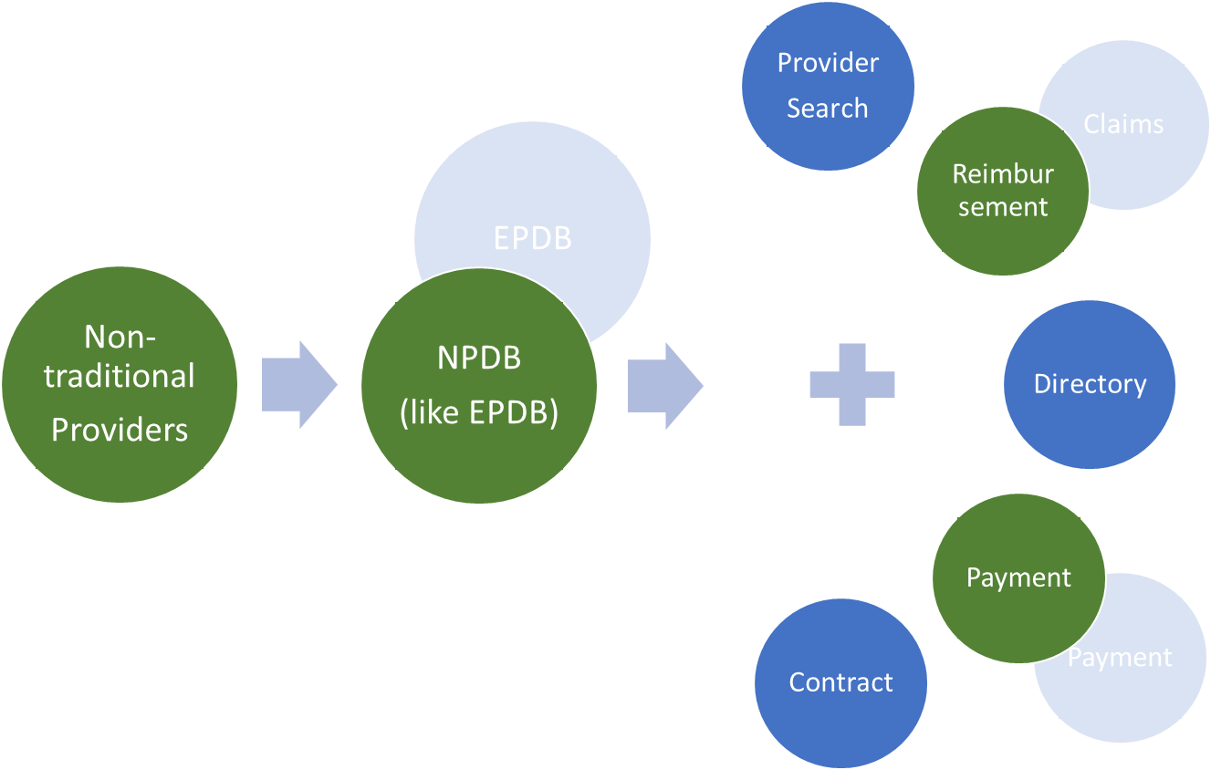
Future Healthcare Provider Management

